Slide 1
Numerical Methods Lec 7
By
Asst. Prof. Syed Shujaat Hussain

Slide 2
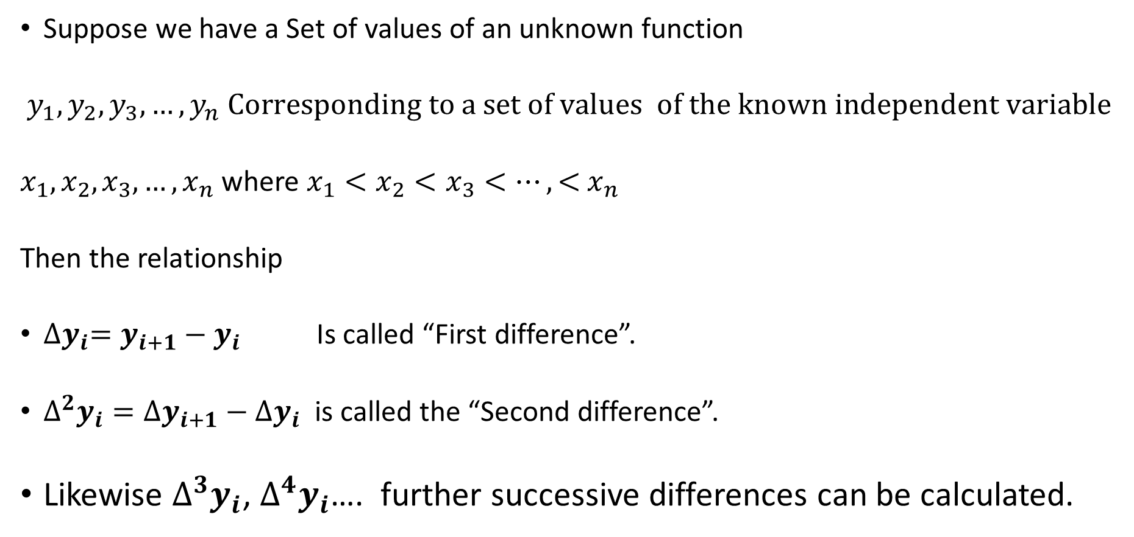
Difference Table
Suppose we have a Set of values of an unknown function
$y_{1},y_{2},y_{3},…, y_{n} Corresponding to a set of values of the known independent variable$
$x_{1},x_{2},x_{3},…,x_{n}$ where $x_{1}<x_{2}<x_{3}<…,<$ $x_{n}$
Then the relationship
${∆y}_{i}=y_{i+1}−y_{i}$ Is called “First difference”.
$∆^{2}y_{i}={∆y}_{i+1}−$ ${∆y}_{i}$ is called the “Second difference”.
Likewise $∆^{3}y_{i}$, $∆^{4}y_{i}$…. further successive differences can be calculated.

Slide 3
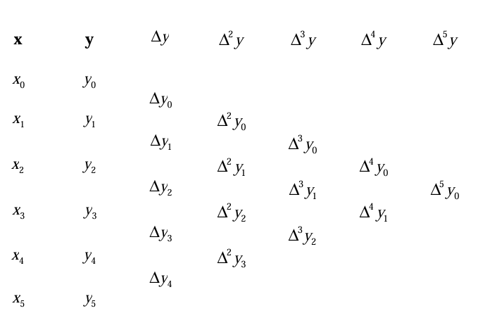
Difference Table
Successive differences can be calculated and put into a table

Slide 4
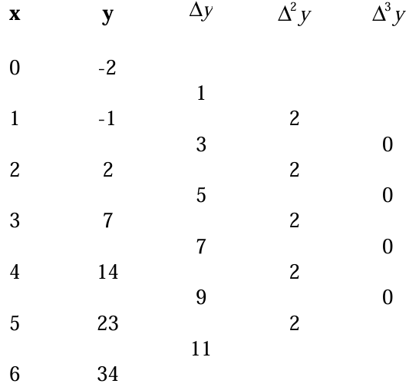
Example
The polynomial interpolation formula , dependent on the n+1 entries can be expressed inn terms of these differences.
Note
In this example, all the differences after the second are zero. This is no coincidence - the nth differences of an n-degree polynomial are always constant, higher differences being zero.

Slide 5
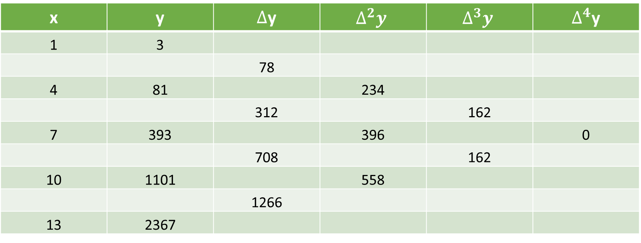
Example
For example difference table of $x^{3}{+x}^{2}+1$ is given as follows
x | y | $∆$y | $$∆^{2}y$$ | $$∆^{3}y$$ | $∆^{4}$y
1 | 3
 |  | 78
4 | 81 |  | 234
 |  | 312 |  | 162
7 | 393 |  | 396 |  | 0
 |  | 708 |  | 162
10 | 1101 |  | 558
 |  | 1266
13 | 2367

Slide 6
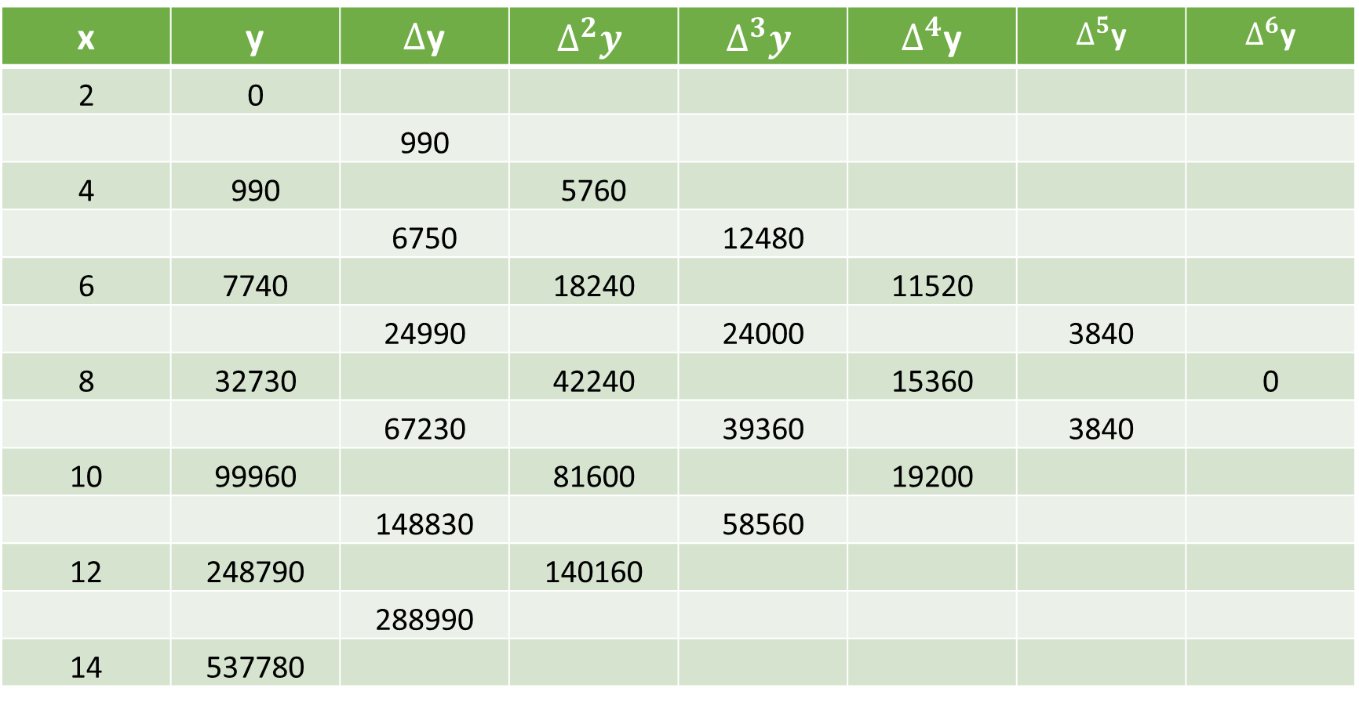
Example
For example difference table of $x^{5}−x−30$ is given as follows
x | y | $∆$y | $$∆^{2}y$$ | $$∆^{3}y$$ | $∆^{4}$y | $∆^{5}$y | $∆^{6}$y
2 | 0
 |  | 990
4 | 990 |  | 5760
 |  | 6750 |  | 12480
6 | 7740 |  | 18240 |  | 11520
 |  | 24990 |  | 24000 |  | 3840
8 | 32730 |  | 42240 |  | 15360 |  | 0
 |  | 67230 |  | 39360 |  | 3840
10 | 99960 |  | 81600 |  | 19200
 |  | 148830 |  | 58560
12 | 248790 |  | 140160
 |  | 288990
14 | 537780

Slide 7
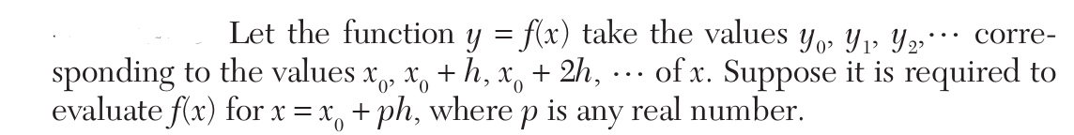
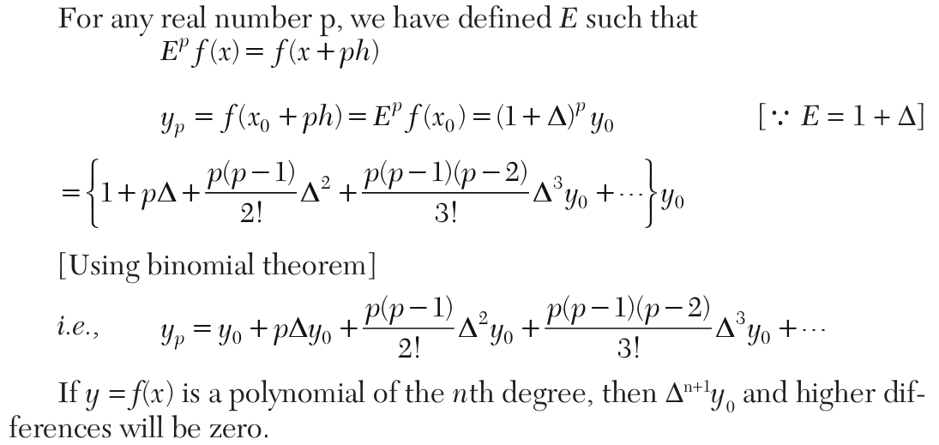
Newton’s forward interpolation formula
ok

Slide 8


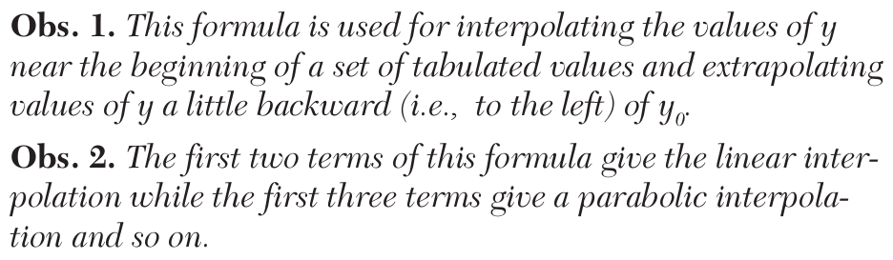
Newton’s forward interpolation formula
Ok
Note

Slide 9
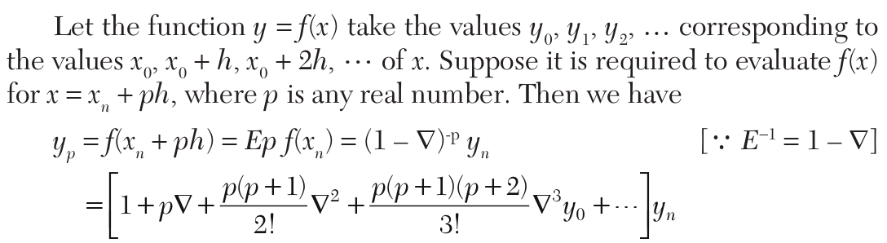
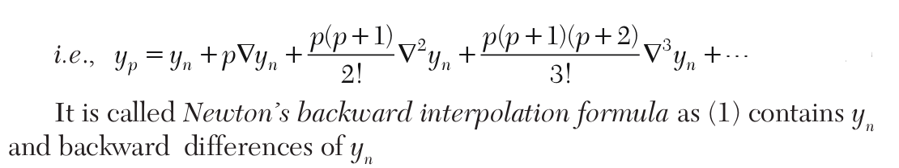
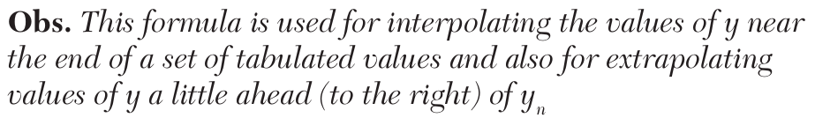
Newton’s Backward Interpolation Formula
ok

Slide 10
Example
Q The table gives the distance in nautical miles of the visible horizon for
the given heights in feet above the earth’s surface
Find the values of “y” when
i) x=160 ft ii) x=410 ft.

Slide 11
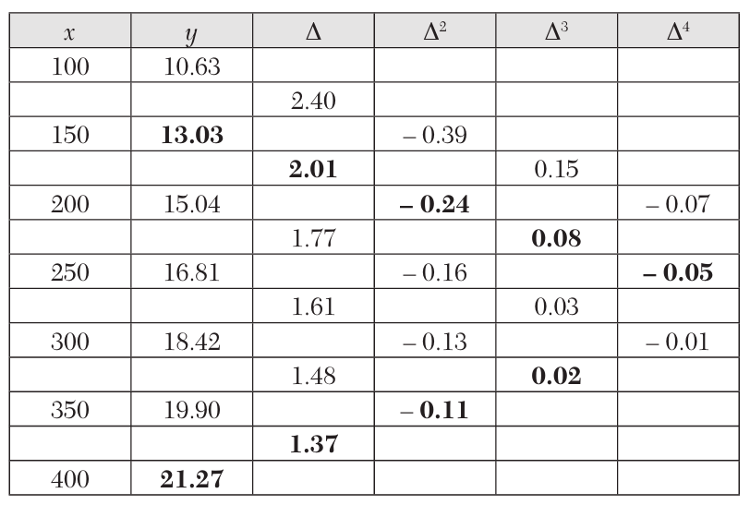
Solution
ok

Slide 12

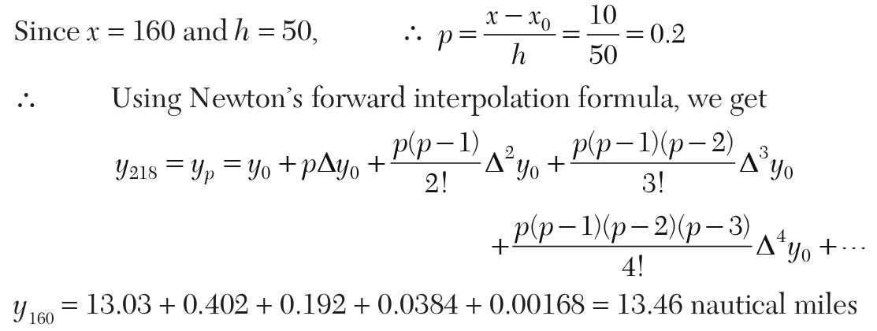

Interpolation
ok

Slide 13
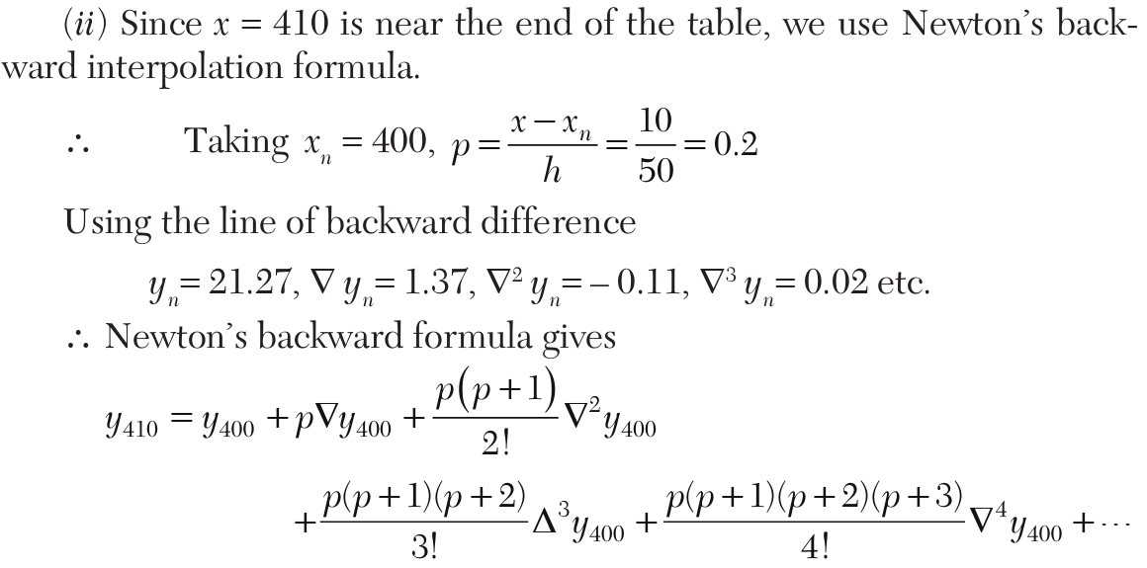
Backward Interpolation
ok

Slide 14
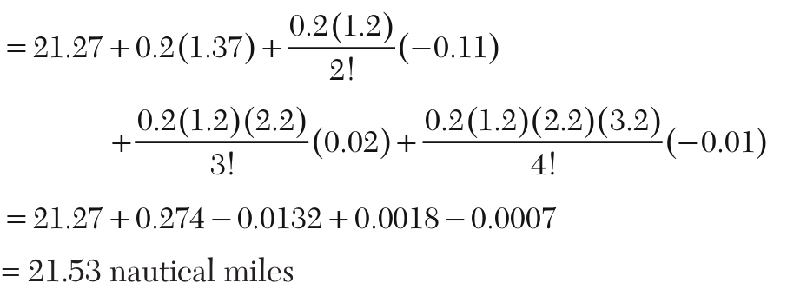
Solution
ok

Slide 15
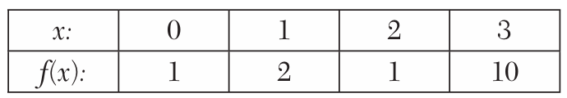


Class Activity
Q Find the cubic polynomial which takes the following values.
Hint: We take

Slide 16
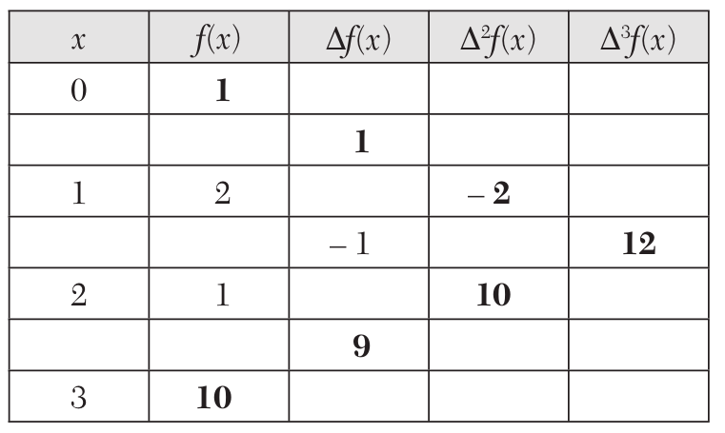
Difference Table
The difference table is

Slide 17
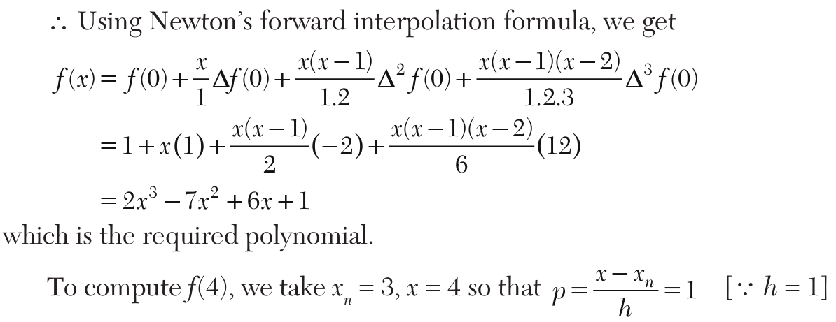
Solution
ok

Slide 18
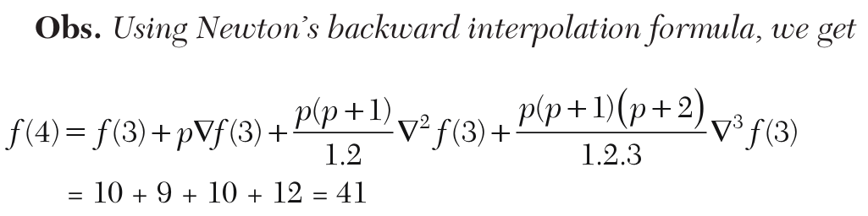
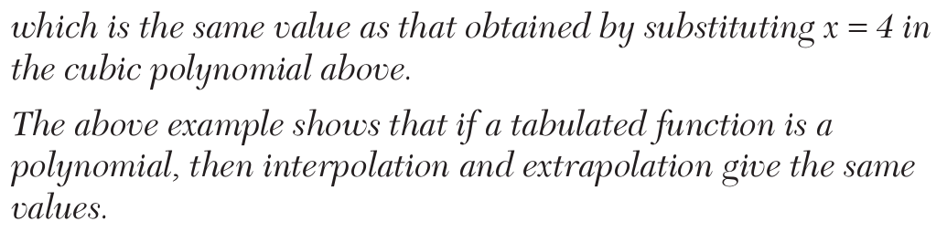
Solution
ok

Slide 19
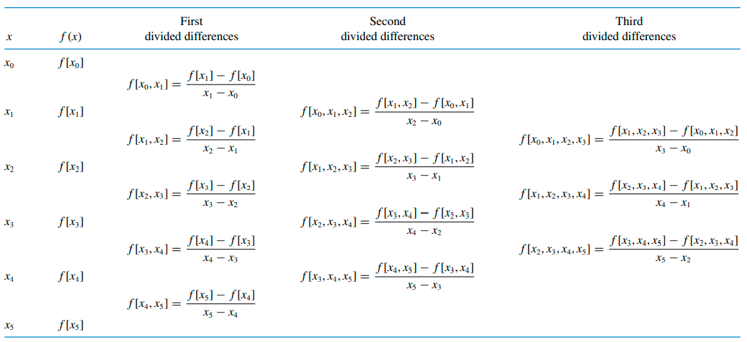
Divided Difference

Slide 20
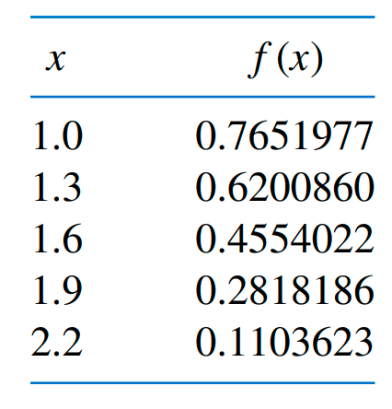
Example Q:Compute the divided difference table for the following data.

Slide 21
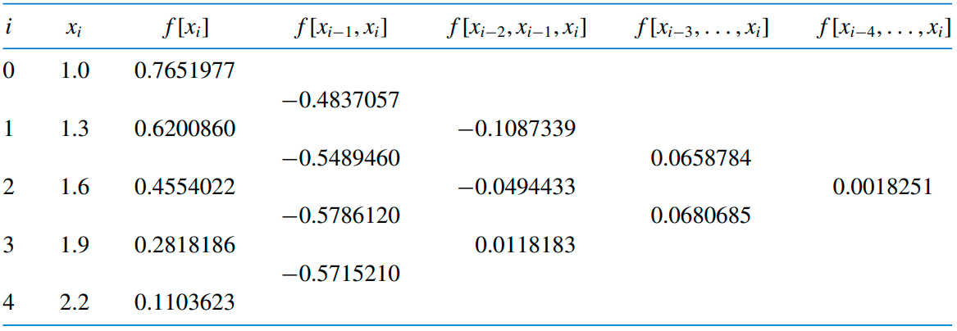
Solution

Slide 22
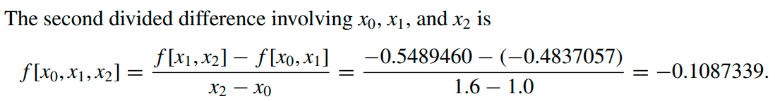
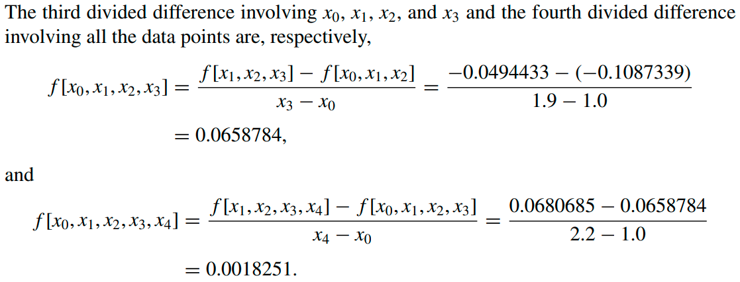
Working

Slide 23
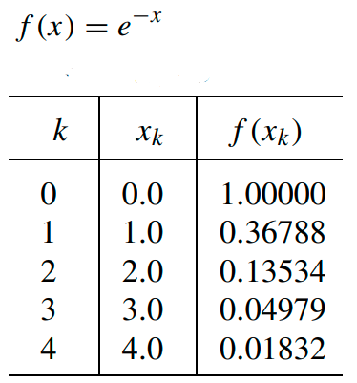
Class Activity Q1: Compute the divided difference table

Slide 24
Newton’s Divided Difference Table
X | Y | DD1 | DD2 | DD3 | DD4
0 | 1
 |  | -0.63212
1 | 0.36788 |  | 0.19979
 |  | -0.23254 |  | -0.0421
2 | 0.13534 |  | 0.073495 |  | 0.006653333
 |  | -0.08555 |  | -0.01549
3 | 0.04979 |  | 0.02704
 |  | -0.03147
4 | 0.01832

Slide 25
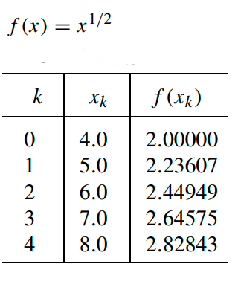
Class Activity Q2: Compute the divided difference table

Slide 26
Newton’s Divided Difference Table
X | Y | DD1 | DD2 | DD3 | DD4
4 | 2
 |  | 0.23607
5 | 2.23607 |  | -0.01132
 |  | 0.21342 |  | 0.000915
6 | 2.44949 |  | -0.00858 |  | -7.95833E-05
 |  | 0.19626 |  | 0.000597
7 | 2.64575 |  | -0.00679
 |  | 0.18268
8 | 2.82843

Slide 27
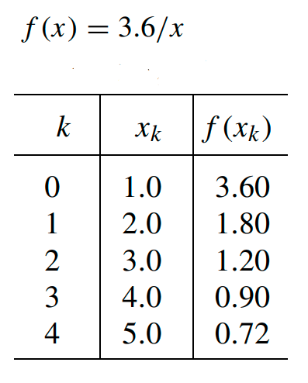
Class Activity Q3: Compute the divided difference table

Slide 28
Newton’s Divided Difference Table
X | Y | DD1 | DD2 | DD3 | DD4
1 | 3.6
 |  | -1.8
2 | 1.8 |  | 0.6
 |  | -0.6 |  | -0.15
3 | 1.2 |  | 0.15 |  | 0.03
 |  | -0.3 |  | -0.03
4 | 0.9 |  | 0.06
 |  | -0.18
5 | 0.72

Slide 29
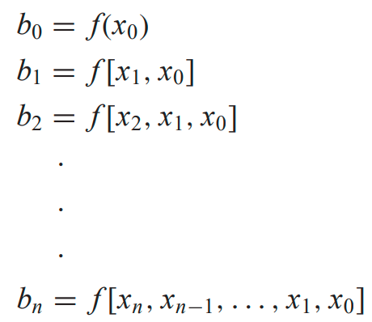

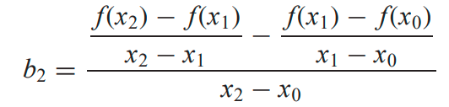
Newton’s Interpolating Polynomial
The nth-order Newton’s polynomial is
For an nth-order polynomial, n + 1 data points are required
Where
for example

Slide 30


Divided Difference
where the bracketed function evaluations are finite divided differences. For example, the first finite divided difference is represented generally as
The second finite divided difference, which represents the difference of two first divided differences, is expressed generally as
Similarly, the nth finite divided difference is

Slide 31
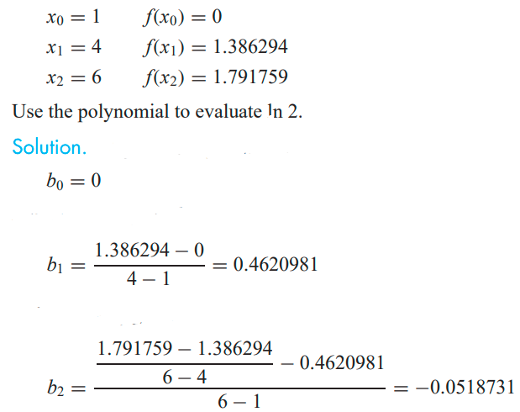
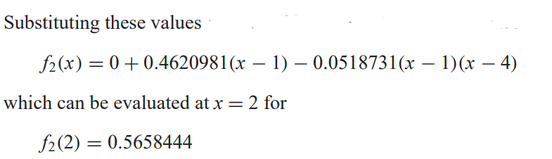
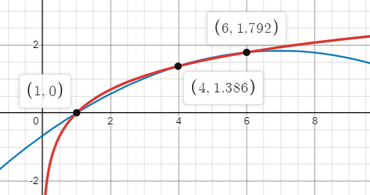
Example Q: Fit a second-order polynomial to the three points from y=lnx
Y = lnx

Slide 32
Class Activity Q: Write down the Newton’s polynomial for example 1 Q: Evaluate it at x= 1.5

Slide 33
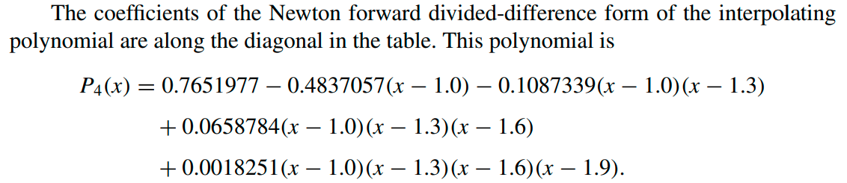

Solution

Slide 34
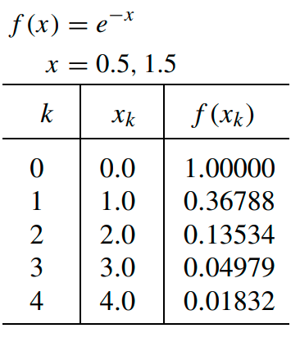
Class Activity Q: Write down the Newton’s polynomial for Class Activity Q1 Q: Evaluate it at x= 1.5

Slide 35
Class Activity Newton’s Divided Difference Table
Q Evaluate Newton’s Polynomial at x= 1.5
X | Y | DD1 | DD2 | DD3 | DD4
0 | 1
 |  | -0.63212
1 | 0.36788 |  | 0.19979
 |  | -0.23254 |  | -0.0421
2 | 0.13534 |  | 0.073495 |  | 0.006653333
 |  | -0.08555 |  | -0.01549
3 | 0.04979 |  | 0.02704
 |  | -0.03147
4 | 0.01832

Slide 36
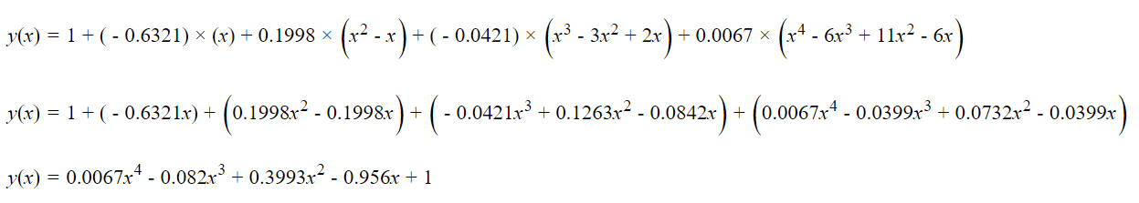
Newton’s Polynomial

Slide 37
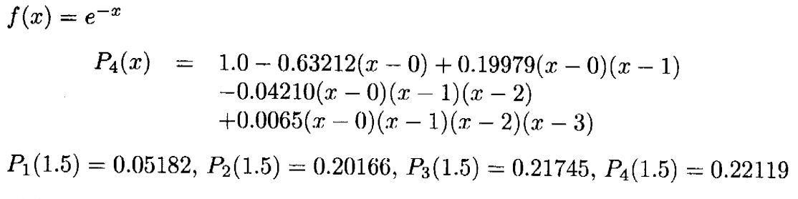
Solution

Slide 38
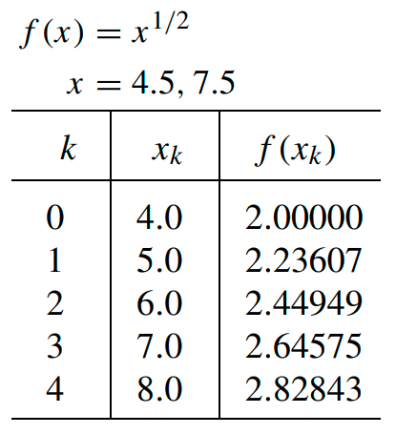
Class Activity Q: Write down the Newton’s polynomial for Class Activity Q2 Q: Evaluate it at x= 4.5

Slide 39
Class Activity Newton’s Divided Difference Table
Q Evaluate Newton’s Polynomial at x= 4.5
X | Y | DD1 | DD2 | DD3 | DD4
4 | 2
 |  | 0.23607
5 | 2.23607 |  | -0.01132
 |  | 0.21342 |  | 0.000915
6 | 2.44949 |  | -0.00858 |  | -7.95833E-05
 |  | 0.19626 |  | 0.000597
7 | 2.64575 |  | -0.00679
 |  | 0.18268
8 | 2.82843

Slide 40
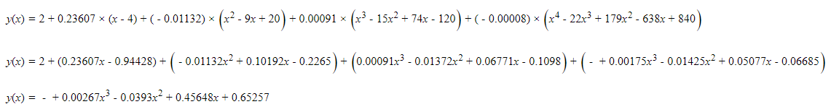
Newton’s Polynomial

Slide 41
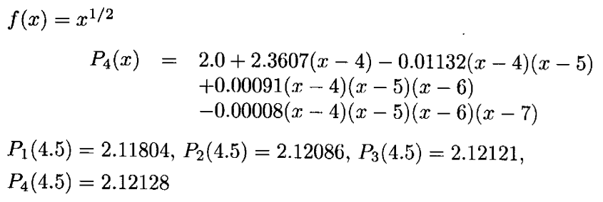
Solution

Slide 42
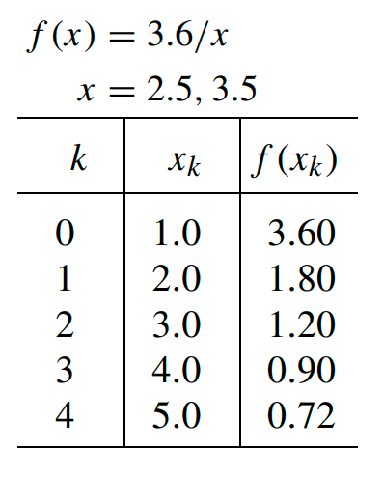
Class Activity Q: Write down the Newton’s polynomial for Class Activity Q2 Q: Evaluate it at x= 2.5

Slide 43
Class Activity Newton’s Divided Difference Table
Q Evaluate Newton’s Polynomial at x= 3.5
X | Y | DD1 | DD2 | DD3 | DD4
1 | 3.6
 |  | -1.8
2 | 1.8 |  | 0.6
 |  | -0.6 |  | -0.15
3 | 1.2 |  | 0.15 |  | 0.03
 |  | -0.3 |  | -0.03
4 | 0.9 |  | 0.06
 |  | -0.18
5 | 0.72

Slide 44
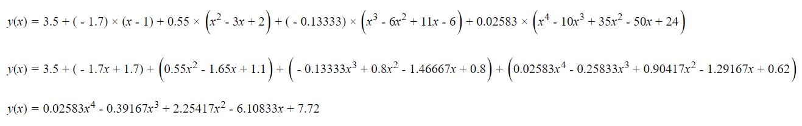
Newton’s Polynomial

Slide 45
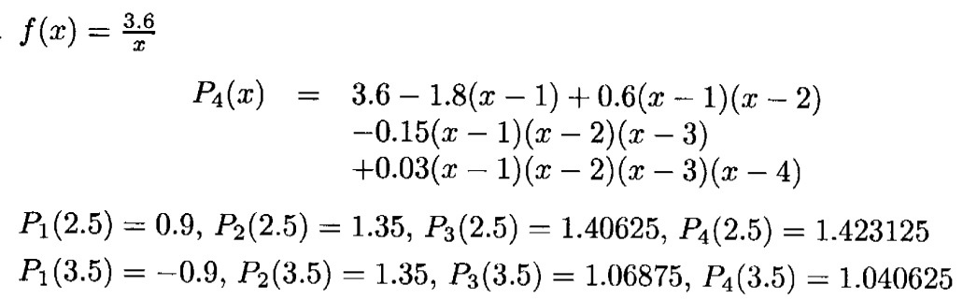
Solution

